Slide 1


18th Nov, 2025
SCIML PROJECT
PRESENTATION
Presented By:
Aditya Prasad
ME 4th year Undergraduate Student

Slide 2
01
ChemNODE-Ammonia: A Neural ODE Surrogate for Stiff Ammonia-Air Combustion Kinetics
Some Basic Questions
What's the Problem?
A 3D simulation (like a flame) is a grid of millions of tiny "boxes" or cells.
The slowest part of the simulation (>90% of CPU time) is solving the complex chemical reactions in every single box.
What is 0D Combustion?
A 0D model is a single "perfectly stirred" box.
It's where we solve the fundamental problem: How do chemicals change over time?
Our Project's Goal:
By building a super-fast Neural Network to solve the 0D problem, we can create a "surrogate" to accelerate the entire 3D simulation.

Slide 3
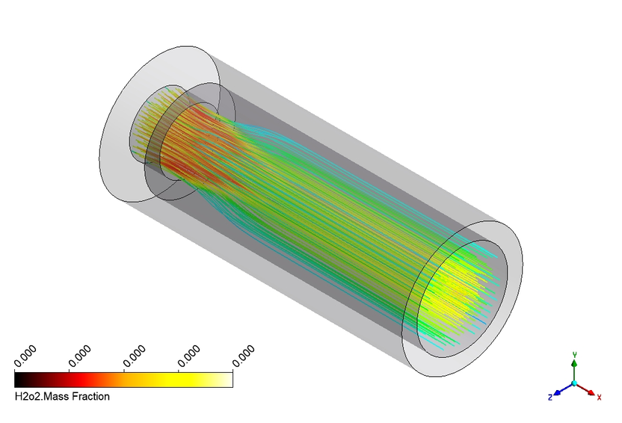
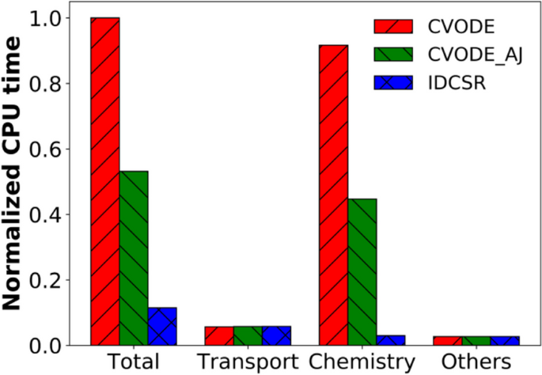

INTRODUCTION & MOTIVATION
What is the problem?
Ammonia (NH3) is a promising carbon-free fuel, essential for decarbonizing sectors like power generation and shipping.
Accurately simulating ammonia combustion is vital for designing efficient, low-NOx engines and turbines.
What is the computational bottleneck?
DETAILED CHEmical mechanisms (e.g., Stagni (2023): 31 species, 203 reactions) are computationally prohibitive.
The problem is "Numerical Stiffness": The system has a massive range of timescales (e.g., fast radicals vs. slow N2 formation).
Stiff solvers (like Cantera's default) must take tiny, slow, and expensive time steps to remain stable.
02

Slide 4
03
PROBLEM STATEMENT & OBJECTIVES
PROBLEM STATEMENT
THE NUMERICAL STIFFNESS OF THE 31-SPECIES AMMONIA MECHANISM MAKES IT COMPUTATIONALLY INTRACTABLE TO COUPLE WITH MULTI-DIMENSIONAL CFD SIMULATIONS.
SPECIFIC GOALS
ACCURACY: THE SURROGATE MUST ACCURATELY PREDICT THE FULL TIME-EVOLUTION OF SPECIES AND TEMPERATURE FOR UNSEEN INITIAL CONDITIONS (T0 & PHI).
Speed: The surrogate must reduce the numerical stiffness, enabling it to be integrated by a fast, explicit ODE solver (like dopri5) and achieve a significant speed-up over the original stiff solver.
01
03
OBJECTIVE
TO DEVELOP A COMPUTATIONALLY-EFFICIENT SURROGATE MODEL THAT ACCURATELY REPRODUCES THE STIFF AMMONIA KINETICS.
02

Slide 5
LITERATURE SURVEY / BACKGROUND
From ResNets to Neural ODEs (NODEs):
A standard ResNet is essentially a discrete-time model (like an Euler-step).
A Neural ODE (Chen et al., 2018) is the continuous-time limit, parameterizing the derivative dh/dt = f(h, t, theta) with a single network.
Key Benefit: It uses the Adjoint Sensitivity Method for backpropagation, achieving a constant O(1) memory cost (unlike ResNets, which are O(L) ).
NODEs for Chemistry (ChemNODE):
The "ChemNODE" framework (Owoyele & Pal, 2022) applies this to chemical kinetics, where the network f learns the chemical source term.
The Critical Challenge: Stability:
Bansude et al. (2023) noted that training NODEs on stiff, multi-scale chemistry data (like combustion) is highly unstable
Their Solution: A novel global min-max normalization of the entire state vector (species and temperature) to regularize the network .
My Project:
This project applies the robust data-driven framework from Bansude et al. to the more complex 31-species ammonia mechanism (they used a 9-species H2 mechanism).
Project.
04

Slide 6
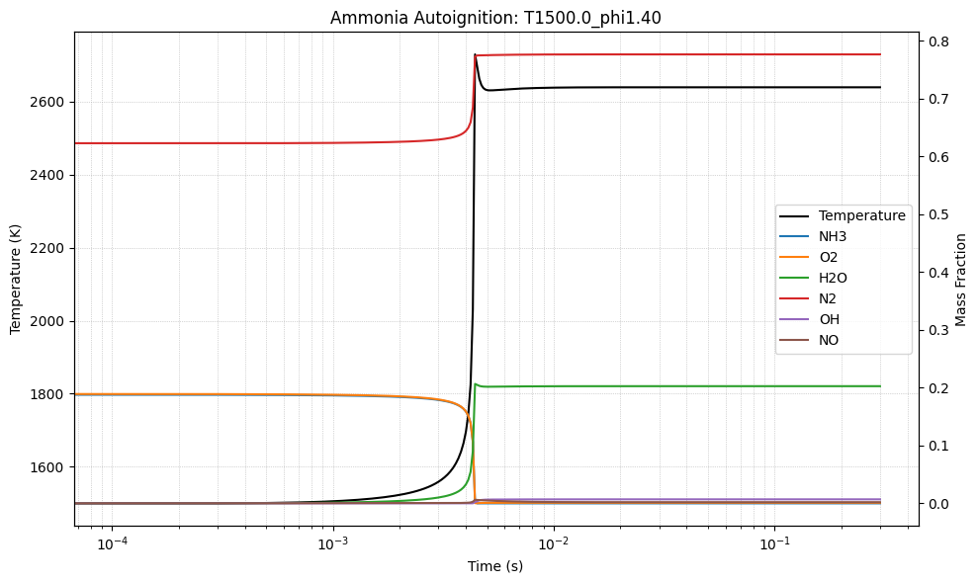
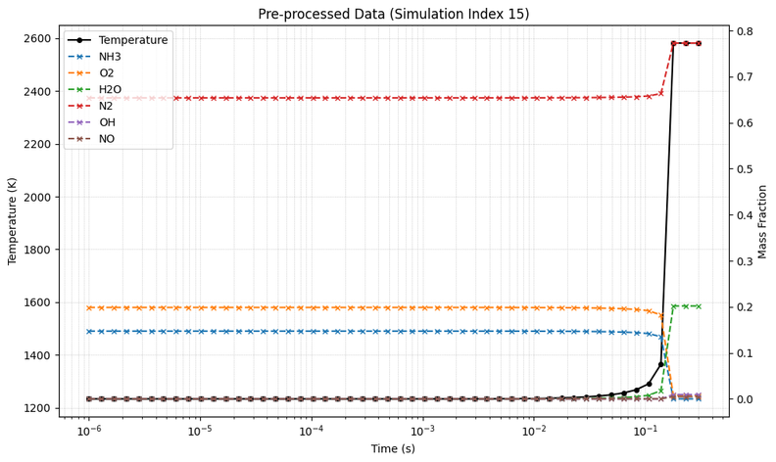
05
METHODOLOGY
Data Generation
Tool: Cantera (Python)
Mechanism: Stagni (2023) - 31 species, 203 reactions
System: 0D, constant-pressure (1 atm) autoignition
Parameter Space: Generated 100 simulations by varying T0 [1000-1500K] and phi [0.6-1.4].
1
Data Pre-processing
The Bansude et al. Method:
1. Normalization: Found the global min/max for all 32 state variables (31 species + T) across the entire dataset. Scaled all data to [0, 1]. This is the key to stable training.
2. Interpolation: Interpolated all 100 trajectories onto a standard, 50-point log-spaced time grid to create uniform batches.
B
2
Studio Shodwe

Slide 7
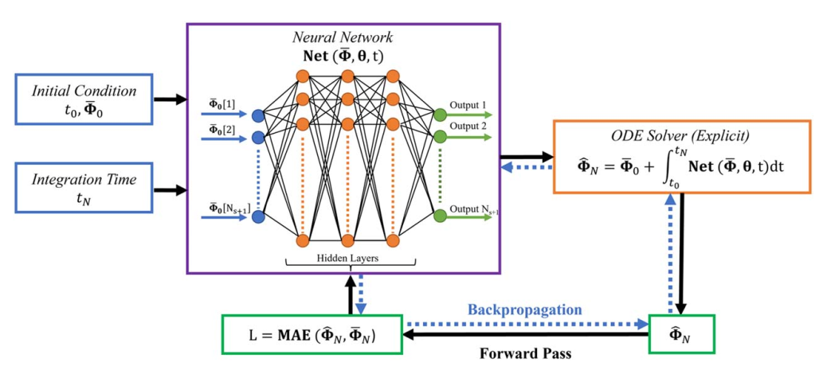
06
The "Physics-Informed" Structure:
We do not learn the state. We train a network (ChemNet) to learn the governing physics (the derivative): du/dt = Net(u, theta)
Model Architecture (model_training.ipynb)
ChemNet: A 4-layer MLP with 256 hidden neurons and ELU activation.
NeuralODE Wrapper: This class (from torchdiffeq) takes the ChemNet as its derivative function.
Training Process:
Solver: odeint integrates ChemNet using a fast, explicit solver (dopri5).
Loss: Mean Absolute Error (MAE) between the integrated solution (u) and the ground truth.
Backprop: Adjoint Sensitivity Method.
Optimizer: Adam with a ReduceLROnPlateau scheduler.
Epochs: 2500
3. MODEL TRAINING

Slide 8
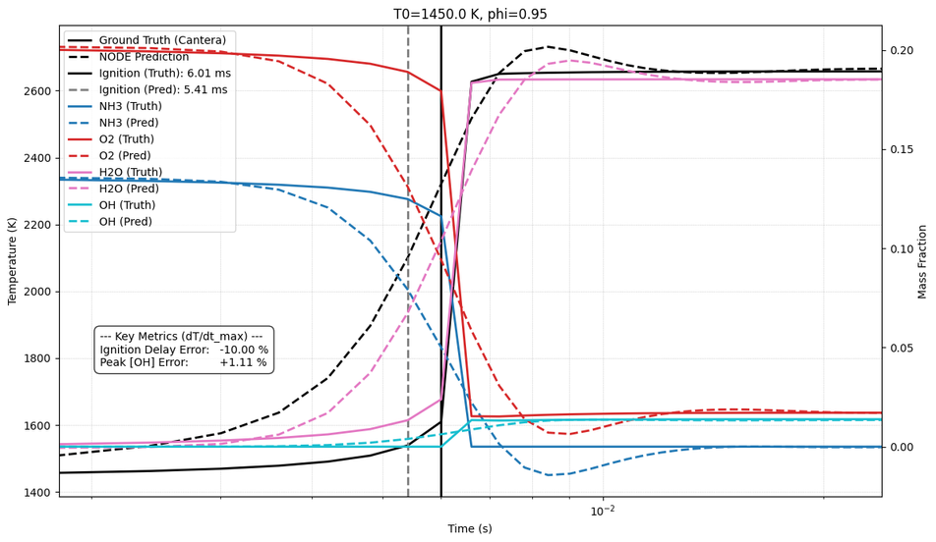
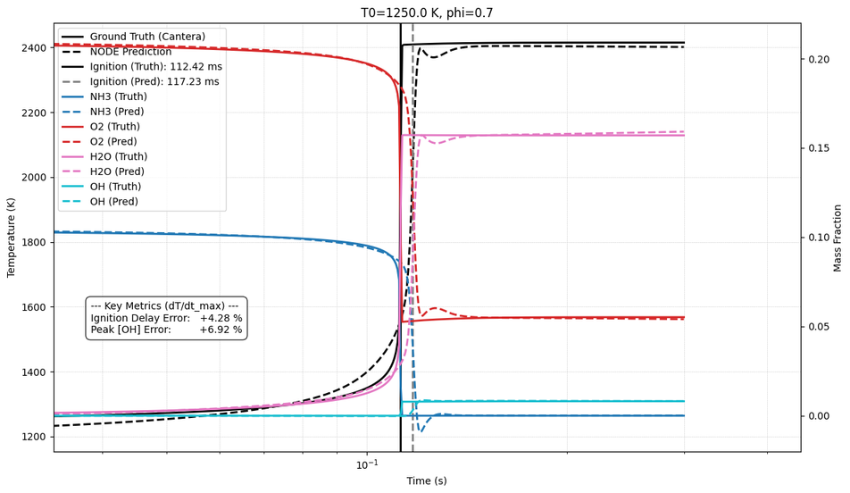
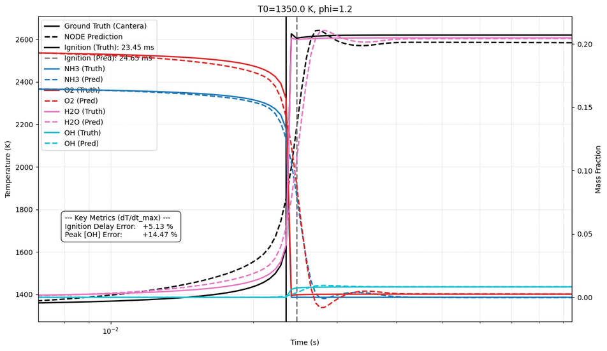
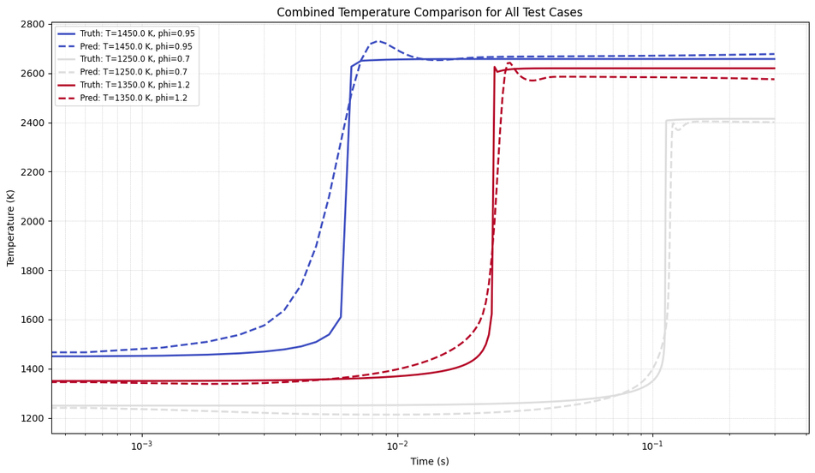
07
The trained model was evaluated on unseen test cases not included in the training set.
Test Case 1: Hot Initial Temp/Lean Mixture
Test Case 2: Warm Initial Temp/Lean Mixture
4. MODEL EVALUATION
Test Case 3: Warm Initial Temp/Rich Mixture

Slide 9
08
CONCLUSION & FUTURE WORK
Conclusion:
Successfully developed and trained a ChemNODE surrogate for the complex 31-species Stagni (2023) ammonia mechanism.
The model is highly accurate, with low error in predicting ignition delay and peak radical concentrations on unseen test cases.
Limitations:
Model is 0D (no spatial effects) and trained for a single pressure (1 atm).
The model is not providing the required computational speed-up that we wanted in the beginning. (I’m still working on it)
Future Scope of Work:
Generalize: Include Pressure (P) as an input to the network.
Add Physics (PINN): Enforce physical constraints (e.g., mass conservation, sum(dY_k/dt = 0) directly in the loss function.
Couple: Integrate this fast 0D surrogate into a 2D/3D CFD code (e.g., OpenFOAM) to accelerate a full reacting flow simulation.

Slide 10
09
REFERENCES
Introduction to Neural ODEs
1. Chen, R. T. Q., Rubanova, Y., Bettencourt, J., & Duvenaud, D. (2018). Neural Ordinary Differential Equations. NeurIPS.
2. Owoyele, O., & Pal, P. (2022). ChemNODE: A Neural Ordinary Differential Equations Framework for Efficient Chemical Kinetic Solvers. Energy and AI.
Introduction to ChemNODEs
Bansude, S., Pal, P., & Bhattacharya, S. (2023). A data-driven framework for integration of chemical kinetics using neural ordinary differential equations. Combustion and Flame.
Reduced Order Reaction Mechanism for Ammonia Combustion
Stagni, A., et al. (2023). Low- and intermediate-temperature ammonia/hydrogen oxidation in a flow reactor. Chemical Engineering Journal.

Slide 11
THANK YOU
ANY QUESTIONS?

